Slide 1
THE 3Rs leaflet

Slide 2
What do you think the 3Rs stand for?
R _ _ _ _ E
R _ _ _ E
R _ _ _ _ _ E

Slide 4
Watch the video below and make a list of all the things we can reduce, reuse or recycle, as mentioned in the video

Slide 5
Group task
Work in groups of three to produce an informative leaflet to raise awareness on the importance of the 3Rs.
STEP 1
Each group member does online research on one of the following aspects
how we can reduce consumption
what we can reuse and how
what we can recycle
STEP 2
Plan your leaflet using all the information you have collected (from the video and from the online sources) and the given layout
STEP 3
Produce your leaflet
STEP 4
Present your leaflet to the class.
Evaluate your own leaflet and presentation as well as your peers’ leaflets and presentations using two assessment sheets.

Slide 6
STEP 1 – DO THE RESEARCH
Divide the roles among the three group members.
Every student will do research on the set topic using the suggested website and two more websites of their choosing.
Every student will save important/useful information (text and pictures) in a common google document. (https://www.google.com/docs/about/
 | Topic | Suggested website
Student A | How to reduce consumption | http://www.rethinkrecycling.com/residents/reduce/top-10-ways-reduce-waste
Student B | What to reduce and how | http://www.recycling-guide.org.uk/reuse.html
Student C | What we can recycle | http://www.wm.com/thinkgreen/what-can-i-recycle.jsp

Slide 7
STEP 2 – PLAN THE LEAFLET
Refine the text you have found in the online sources so you can have 5 tips for each of the three sections (Reduce/ Reuse/ Recycle) accompanied by 1 or more illustrative pictures
Search for one illustrative quote to illustrate the topic
Write a 50-70 word paragraph in which you present the group’s opinion on why we should care about the environment
Select two illustrative pictures (one for the front part and one for the back part of your leaflet)
Create a slogan for your leaflet, which will act as a title.

Slide 8
Language features
Express the tips using (at least) 5 of the following vocabulary and grammar structures, to ensure your tone is persuasive
direct address
rhetorical questions
imperatives
colloquial language
adjectives/adverbs
facts/figures
quotes

Slide 9
STEP 3 – produce your leaflet, using the template you can find here and on the dedicated padlet page - https://padlet.com/cnog/the3Rs

Slide 10
The template for the outer page

Slide 11
The template for the inner page

Slide 12
When you have finished your leaflet use this checklist and tick the boxes.
If necessary, redraft and improve your leaflet so that you can tick all the boxes.
Have you included: | ✓
A title page with a slogan
Your group opinion on why we should care about the environment
5 “Reduce” tips
5 “Reuse” tips
5 “Recycle” tips
1 or more images for each section
Reference to websites used – webography
Persuasive features – (at least) 5 of the following:
direct address
rhetorical questions
imperatives
colloquial language
adjectives/adverbs
facts/figures
quotes
Does your leaflet: | ✓
Give information about reducing/ reusing/ recycling
Explain why reducing/ reusing/ recycling is necessary
Explain what action people can take
Have you checked spelling, grammar and punctuation thoroughly?

Slide 13
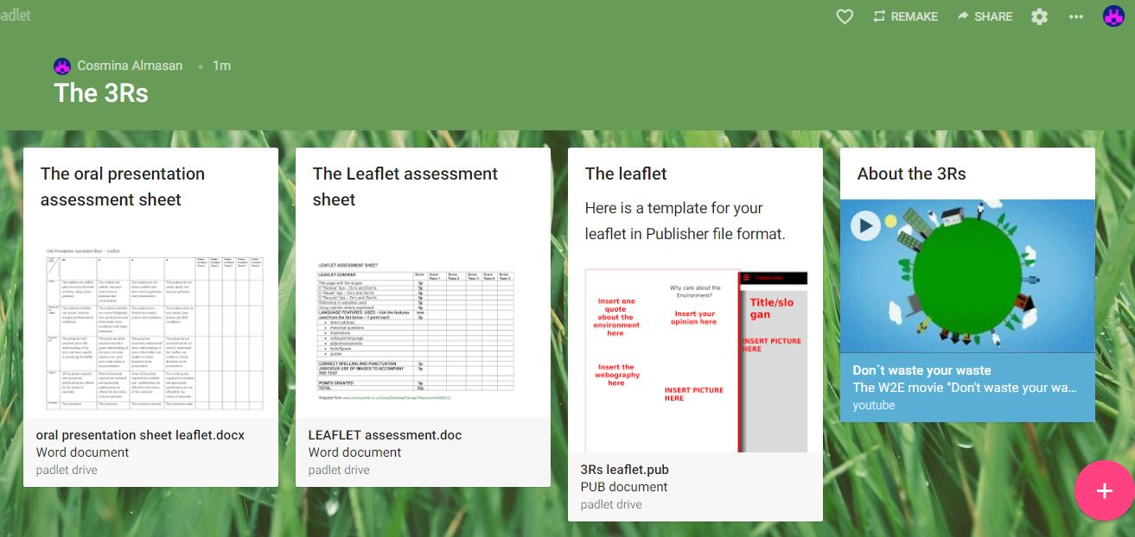
PROJECT ASSESSMENT
50 % leaflet assessment
50% oral presentation assessment
NOTE: the final result will be calculated as the average of self assessment, peer assessment and teacher assessment, using the same assessment sheet – to be downloaded from the dedicated padlet page - https://padlet.com/cnog/the3Rs

